Slide 1
BIG MOUNTAIN RESORT
The Best
$$
Winter
Ticket
TERRY A. MEYER | A DATA DRIVEN SOLUTION | JUNE 6, 2023

Slide 2
THE BUSINESS PROBLEM What changes can Big Mountain Resort make to their facilities before opening day to lower operating costs and increase customer visits while maintaining or increasing the current ticket price?
SUCCESS CRITERIA
Ticket price recommendation at or above current strategy for upcoming ski season
Data driven understanding of Big Mountain Resort’s competitive edge and challenges in terms of facilities
Data driven recommendation(s) of Big Mountain Resort’s investment opportunities to increase market value

Slide 3
Big Mountain Resort has a leading number of features that support higher ticket pricing!
Thanks for the features!
Vertical Drop
Acres covered by snow makers
# of fast quad lifts
Total # of chairlifts
Total # of runs
Longest run length
Skiable terrain

Slide 8
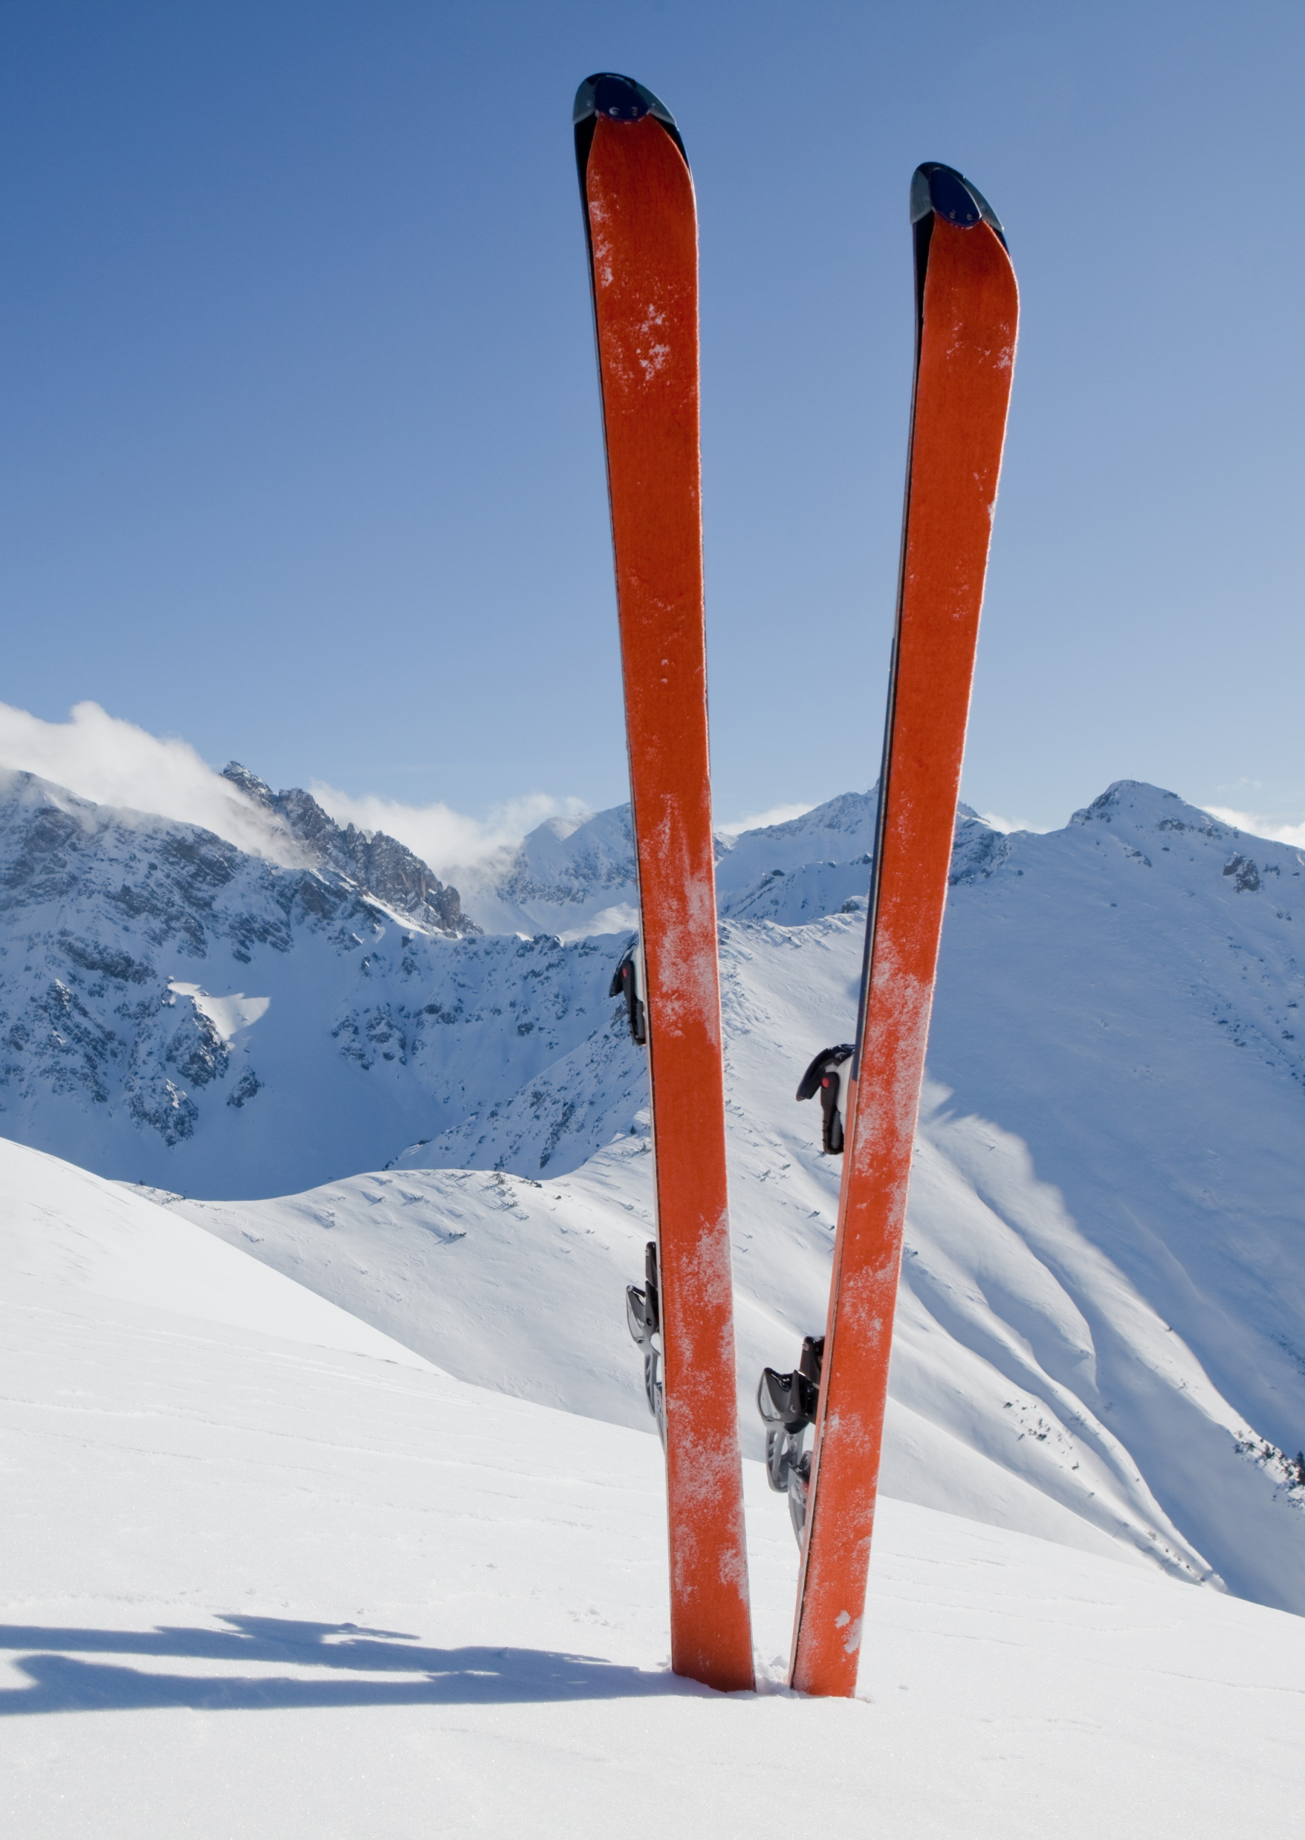
TICKET PRICE RECOMMENDATIONS
Data modelling suggests that Big Mountain could charge as high as $95 +/- $10.
Among the business options you proposed the modeling suggests increasing the vertical drop by adding a run to a point 150 feet lower down with the installation of an additional chair lift to bring skiers back up, without additional snow making coverage, is the most profitable.

